Slide 1


JAVA INTERVIEW BOOTCAMP CORE CONCEPTS
Lecture 20
Strings

Slide 2
CHAPTER 20
Strings
Topics Covered
The String class
The StringBuffer class
The StringBuilder class

Slide 3
What Is A String ?
In Java, a string is defined as a sequence of characters.
But, unlike many other languages that implement strings as character arrays, java implements strings as objects of type String.

Slide 4
How To Represent Strings In Java ?
Java handles Strings by three classes:
String
StringBuffer and
StringBuilder
All are defined in the package java.lang and and most interviews cover only String and StringBuffer classes

Slide 5
String V/s StringBuffer V/s StringBuilder
String | StringBuffer | StringBuilder
Added from JDK 1.0 | Added from JDK 1.0 | Added from JDK 5.0
String objects are immutable | StringBuffer objects are mutable | StringBuilder objects are mutable
String objects are stored in heap and string constants are stored in “String Pool” | StringBuffer objects are stored in heap | StringBuilder objects are stored in heap
Thread-Safe | Thread-Safe | Not Thread-Safe
Fast performance | Very slow performance | Fast performance

Slide 6
Important Facts About “String”
String is probably the most commonly used class in java library.
String class is encapsulated under java.lang package.
In java, every string that you create is actually an object of type String.
One important thing to notice about string object is that string objects are immutable

Slide 7
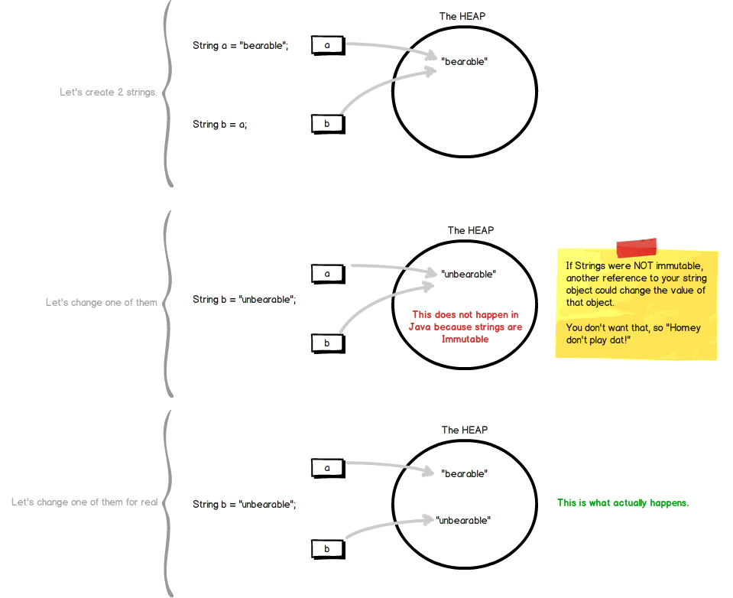
What Is An Immutable Object ?

Slide 8
Creating “String” Object
Java provides 2 ways to create “String” objects
Using “String Literal”
Using new keyword

Slide 9
String Literals…
are anonymous objects of the String class
are defined by enclosing text in double quotes. “Bhopal”
can be passed to methods and constructors as parameters.
have methods we can call.

Slide 10
String Literal Examples
//assign a literal to a String variable
String name = “Sachin”;
//calling a method on a literal String
int len = “Sachin”.length( );

Slide 11
Using The new Keyword
Using the new operator creates a memory location on the heap.
Example:
String name=new String(“Sachin”);
name
“Sachin”

Slide 12
What Is The Difference ?
String literals reside in a special area of memory called “String Constant Pool” while string objects live in heap.
When the compiler encounters a String literal, it checks the pool to see if an identical String already exists.
If a match is found, the reference to the new literal is directed to the existing String, and no new String literal object is created. (The existing String simply has an additional reference.)

Slide 13
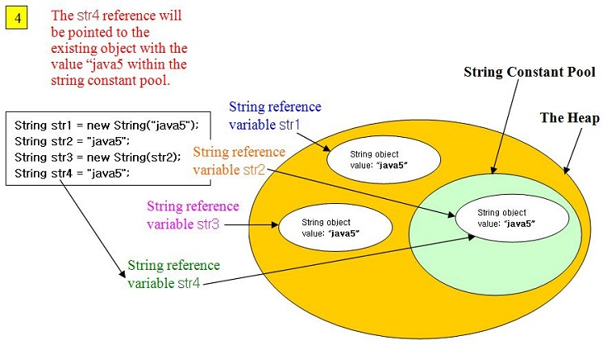
What Is The Difference ?

Slide 14
Empty Strings
An empty String has no characters. It’s length is 0.
Not the same as an uninitialized String.
String word1 = "";
String word2 = new String();
Empty strings
private String name;
name is null

Slide 15
No Argument Constructors
No-argument constructor creates an empty String.
A more common approach is to assign the variable to an empty literal String.
String empty = new String();
String empty = “”;//nothing between quotes

Slide 16
Copy Constructors
Copy constructor creates a copy of an existing String.
Not the same as an assignment.
Copy Constructor: Each variable points to a different copy of the String.
String word = new String(“Java”); String word2 = new String(word);
word
“Java"
word2
“Java"
Assignment: Both variables point to the same String.
String word = “Java”; String word2 = word;
word
“Java"
word2
String word3= “Java”;
word3

Slide 17
Other Constructors
Most other constructors take an array as a parameter
to create a String.
char[] letters = {‘J’, ‘a’, ‘v’, ‘a’}; String word = new String(letters);//”Java”

Slide 18
Methods — length, charAt
int length();
char charAt(int i);
Returns the number of characters in the string
Returns the char at position i.
Character positions in strings are numbered starting from 0 – just like arrays.
Returns:
”Problem”.length();
”Window”.charAt (2);
7
’n'

Slide 19
What Is The Output ?
String x=“test”;
System.out.println(x.length);
String [ ] months=new String[12];
System.out.println(months.length());
Both codes will produce syntax error!

Slide 20
Why ?
Arrays have an attribute (not a method) called length, while String objects have a method called length() ( not an attribute)
So an attempt to use the length() method on an array or an attempt to use the length attribute on a String, both cause compiler error

Slide 21
Methods — substring
Returns a new String by copying characters from an existing String.
String subs = word.substring (i, k);
returns the substring of chars in positions from i to k-1
String subs = word.substring (i);
returns the substring from the i-th char to the end
television
i k
television
i
Returns:
”television”.substring (2,5);
“immutable”.substring (2);
“hello”.substring (5);
“lev”
“mutable”
"" (empty string)

Slide 22
Methods — Find (indexOf)
0 2 6 10 15
String name =“President George Washington";
name.indexOf (‘P'); 0
name.indexOf (‘e'); 2
name.indexOf (“George"); 10
name.indexOf (‘e', 3); 6 6
name.indexOf (“Bill"); -1
name.lastIndexOf (‘e'); 15
Returns:
(starts searching at position 3)
(not found)
Notes:
String has four overloaded versions of indexOf and four versions of lastIndexOf.
lastIndexOf(ch, fromPos) starts looking at fromPos and goes backward towards the beginning of the string.

Slide 23
Methods — Concatenation
String word1 = “re”, word2 = “think”; word3 = “ing”;
int num = 2;
String result = word1 + word2;
//concatenates word1 and word2 “rethink“
String result = word1.concat (word2);
//the same as word1 + word2 “rethink“
result += word3;
//concatenates word3 to result “rethinking”
result += num;
//converts num to String and concatenates it to result “rethinking2”

Slide 24
Methods — Equality
boolean equals(Object)
returns true if the string word1 is equal to word2
boolean equalsIgnoreCase(String)
returns true if the string word1 matches word2, case-blind
b = “Bhopal”.equals(“Bhopal”);//true
b = “Bhopal”.equals(“bhopal”);//false b = “Bhopal”.equalsIgnoreCase(“bhopal”);//true
Notes:
You cannot use relational operators for comparing the contents of strings.
word1.compareTo(word2) returns an int. Basically if word1 is “smaller” than word2, the result is negative, and if word1 is “larger” the result is positive. compareTo returns 0 whenever equals returns true.
Here is how Java docs describe compareTo:
Compares two strings lexicographically. The comparison is based on the Unicode value of each character in the strings. The character sequence represented by this String object is compared lexicographically to the character sequence represented by the argument string. The result is a negative integer if this String object lexicographically precedes the argument string. The result is a positive integer if this String object lexicographically follows the argument string. The result is zero if the strings are equal; compareTo returns 0 exactly when the equals(Object) method would return true.
This is the definition of lexicographic ordering. If two strings are different, then either they have different characters at some index that is a valid index for both strings, or their lengths are different, or both. If they have different characters at one or more index positions, let k be the smallest such index; then the string whose character at position k has the smaller value, as determined by using the < operator, lexicographically precedes the other string. In this case, compareTo returns the difference of the two character values at position k in the two string — that is, the value:
this.charAt(k)-anotherString.charAt(k)
If there is no index position at which they differ, then the shorter string lexicographically precedes the longer string. In this case, compareTo returns the difference of the lengths of the strings — that is, the value:
this.length()-anotherString.length()

Slide 25
Methods — Comparisons
int compareTo(Object)
String s1=“Bhopal”;
String s2=“bhopal”;
int ans=s1.compareTo(s2);
System.out.println(ans);
//Will print -32
Notes:
You cannot use relational operators for comparing the contents of strings.
word1.compareTo(word2) returns an int. Basically if word1 is “smaller” than word2, the result is negative, and if word1 is “larger” the result is positive. compareTo returns 0 whenever equals returns true.
Here is how Java docs describe compareTo:
Compares two strings lexicographically. The comparison is based on the Unicode value of each character in the strings. The character sequence represented by this String object is compared lexicographically to the character sequence represented by the argument string. The result is a negative integer if this String object lexicographically precedes the argument string. The result is a positive integer if this String object lexicographically follows the argument string. The result is zero if the strings are equal; compareTo returns 0 exactly when the equals(Object) method would return true.
This is the definition of lexicographic ordering. If two strings are different, then either they have different characters at some index that is a valid index for both strings, or their lengths are different, or both. If they have different characters at one or more index positions, let k be the smallest such index; then the string whose character at position k has the smaller value, as determined by using the < operator, lexicographically precedes the other string. In this case, compareTo returns the difference of the two character values at position k in the two string — that is, the value:
this.charAt(k)-anotherString.charAt(k)
If there is no index position at which they differ, then the shorter string lexicographically precedes the longer string. In this case, compareTo returns the difference of the lengths of the strings — that is, the value:
this.length()-anotherString.length()

Slide 26
Methods — Comparisons
int compareToIgnoreCase(String)
String s1=“Bhopal”;
String s2=“bhopal”;
int ans=s1.compareToIgnoreCase(s2);
System.out.println(ans);
//Will print 0
Notes:
You cannot use relational operators for comparing the contents of strings.
word1.compareTo(word2) returns an int. Basically if word1 is “smaller” than word2, the result is negative, and if word1 is “larger” the result is positive. compareTo returns 0 whenever equals returns true.
Here is how Java docs describe compareTo:
Compares two strings lexicographically. The comparison is based on the Unicode value of each character in the strings. The character sequence represented by this String object is compared lexicographically to the character sequence represented by the argument string. The result is a negative integer if this String object lexicographically precedes the argument string. The result is a positive integer if this String object lexicographically follows the argument string. The result is zero if the strings are equal; compareTo returns 0 exactly when the equals(Object) method would return true.
This is the definition of lexicographic ordering. If two strings are different, then either they have different characters at some index that is a valid index for both strings, or their lengths are different, or both. If they have different characters at one or more index positions, let k be the smallest such index; then the string whose character at position k has the smaller value, as determined by using the < operator, lexicographically precedes the other string. In this case, compareTo returns the difference of the two character values at position k in the two string — that is, the value:
this.charAt(k)-anotherString.charAt(k)
If there is no index position at which they differ, then the shorter string lexicographically precedes the longer string. In this case, compareTo returns the difference of the lengths of the strings — that is, the value:
this.length()-anotherString.length()

